Slide 1
Curriculum Night 2020 - 2021

Slide 2
Table of Contents
CONNECT
Join PTO
Teacher #1
Teacher #2
POLICY
Code of Conduct
Attendance
Grading
Assessments
Communication
ACADEMICS
Standards Mastery Framework
Reading
Social Studies
Writing
Science
Math
RESOURCES & TECHNOLOGY
i-Ready
Extension Options
Microsoft Teams

Slide 3
CONNECT

Slide 4
Join PTO
Barnwell PTO
Link to PTO Website
Link to PTO Membership Toolkit
The PTO meeting is tonight, Wednesday 9/9 at 7:45. The meeting will take place on Zoom. The join code was included in Mr. Neuhaus' 9/3 Principal Newsletter.
Watch the Barnwell PTO video above!

Slide 5
All About Mr. Chesher
Grew up on a farm outside of Toledo, OH and moved to Atlanta after college. My entire family lives here now.
- I received my Bachelors in Education from Heidelberg College and my Masters in Educational Technology from Lesley University.
- I’ve taught all grades K-5 and this will be my 16th year of teaching.
- Running, cooking, and reading are my three favorite hobbies.

Slide 6
All About Mrs. Levi
From Chicago and Tampa
Went to Auburn for my undergraduate and received my Bachelors in Special Education
Graduated with my Masters in General Education from Georgia Southern
I have been teaching for 14 years in grades PK-5th
My family: Husband (Jose), Isla (5), Ellie (4) and our dog Wrigley (8-year-old Labradoodle)
I love sports, yoga and spending time with the family

Slide 7
POLICY

Slide 8
Code of Conduct
Please review the code of conduct using the link below. Please discuss with your child at home.
URL Code of Conduct

Slide 9
Attendance
Grade Levels | How frequently is participation marked?
Pre-K (Bright From the Start) | Daily during homeroom
K-1st Grade | 1 time weekly during homeroom(based on Learning Bundles)*
2nd Grade (without FCS provided devices) 2nd Grade (with FCS provided devices) | 1 time weekly, during Math and Reading(based on Learning Bundles)* Daily, during Math and Reading
3rd-5th Grade | Daily, during Math and Reading

Slide 10
Attendance
During Universal Remote Learning, students are marked “participated” by their teacher when a student either attends a synchronous lesson, communicates directly with the school, or submits a work assignment. For different grade levels, this happens at a different frequency as listed below:
When is a student marked absent for the day?
For any class where a student is not marked as participated, a “Virtual Absence” will appear in the Campus student and parent portal the next day.
A student is only marked ABSENT for the day if they did not participate for the entire day.

Slide 11
Grading

Slide 12
Assessments
Formative Scores
Grades reported to communicate how student learning is monitored during instruction.
Occur throughout a unit to give students and parents feedback on where the student is with the understanding of a concept.
Used as feedback only during URL.
Summative Scores
Used to communicate mastery of a standard
Summative evaluation occurs after instruction and up to a few times throughout a unit.
Typically these are tests, projects, presentations, and other culminating activities.
Counted as 100% of the student's grade during URL.
Infinite Campus: If you have not set up your Parent Portal account, please follow the steps here.

Slide 13
Communication
Teacher-Parent - Newsletters and Email
Teacher-Students - Announcements on Teams, Email, Small Group Feedback
Assignments - Students can share assignment progress with you by clicking on their Assignments tab in Microsoft Teams.
Grades - Infinite Campus-Please be sure you are registered so that you can see your child's grades.

Slide 14
ACADEMICS

Slide 15
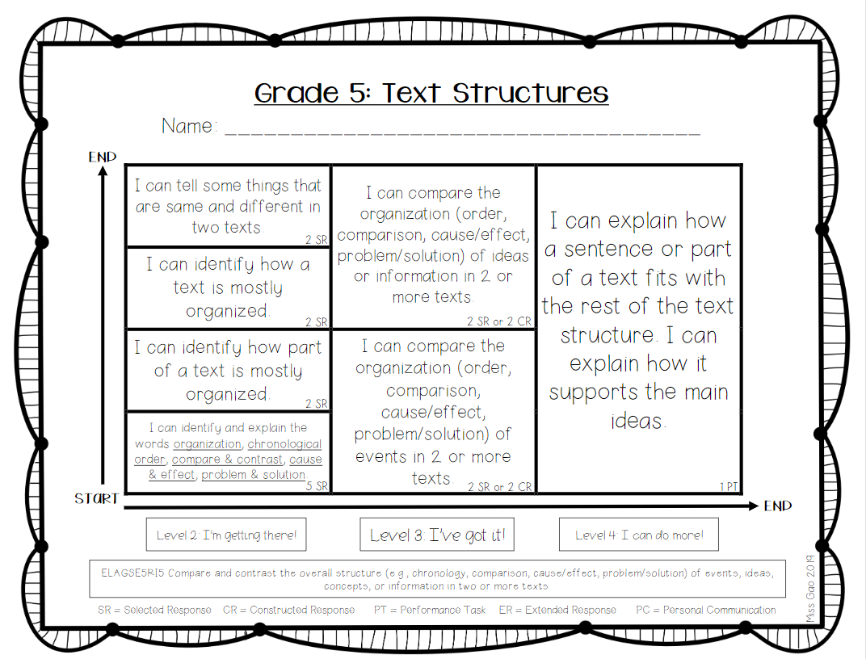
Standards Mastery Framework
This year we will use "Learning Maps" to help students understand their learning goals.
These maps are based on the prioritized 5th grade standards.
This is an example learning map for reading standard RI5.

Slide 16
Reading
Unit 1 Character Studies
Unit 2 Nonfiction
Unit 3 Theme in Complex Texts
Unit 4 Argument & Advocacy
Unit 5 Fantasy
Students will learn through...
Book studies, group work, and independent work
Fiction and Nonfiction texts
Book Clubs: Students are placed into fluid reading groups according to their reading level, which will be monitored throughout the year. They will not be limited to books at this level
ELA Prioritized Standards

Slide 17
Social Studies
Unit 1 Turn of the Century
Unit 2 World War 1
Unit 3 Great Depression & The New Deal
Unit 4 World War 2
Unit 5 Cold War
Unit 6 Civil Rights
Unit 7 1975-Today
Students will learn through...
Analyzing Primary Sources
Gallopade Textbook
Whole group and small group discussion
Several of the units we cover discuss sensitive topics including war, prejudice, and persecution. Students need to come prepared to have mature conversations about these topics.
Social Studies Prioritized Standards

Slide 18
Writing
Unit 1 Narrative Writing
Unit 2 Informational Writing
Unit 3 Opinion Writing
Students will learn through...
Writer's Workshop
Grammar integration
ELA Curriculum Georgia Standards of Excellence
Standards of Mastery Framework

Slide 19
Science
Unit 1 Electricity and Magnetism
Unit 2 Cells
Unit 3 Helpful/Harmful Microorganisms
Unit 4 Constructive and Destructive Processes
Unit 5 Matter –Physical and Chemical Changes
Unit 6 Classification of Plants and Animals
Unit 7 Inherited Behavior
Students will learn through...
STEM Labs (hands-on or virtual)
Research Projects
Multi-Media Resources (text, video, games, etc.)
Science Curriculm with Prioritized Standards
Standards Mastery Framework

Slide 20
Math
What do these numbers mean?
The first number is the grade level. The second number is the semester.
5.1 First semester of "on" level | 5.2 First semester of "advanced" math | 6.1 First semester of "accelerated" math | 6.2
Unit 1: Order of Operations & Whole Numbers Unit 2: Adding & Subtracting Decimals Unit 3: Multiplying & Dividing Decimals | Unit 4: Adding, Subtracting, Multiplying, & Dividing Fractions Unit 5: 2D Figures Unit 6: Geometry Unit 7: Geometry & the Coordinate Plane | Unit 1: Number System Fluency Unit 2: Rate, Ratio, & Proportional Reasoning Using Equivalent Fractions Unit 3: Expressions Unit 4: One Step Equations & Inequalities | Unit 5 Area & Volume Unit 6 Statistics Unit 7 Rational Explorations: Numbers & their Opposites
Students will learn through...
Gradual Release Model (“I do”, “We do”, “You do”)
Concrete, Representational, Abstract – Start with manipulatives/drawings, then move toward algorithms
Real-World Situations and Projects
Flexible Small Groups
Link to 6th Grade Prioritized Math Standards
Link to 5th Grade Prioritized Math Standards
Link to Interactive Study Guide

Slide 21
RESOURCES & TECHNOLOGY

Slide 22
Adaptive Software Lessons Personalized Student Track Teacher Assigned: Based on Current Classroom Topics
Notes:
iReady
All students in Grades K-10 will take the winter diagnostic along with students in Grades 11-12 who score 30%ile and below in fall.
The i-Ready diagnostic will be administered to Grades 3-12 at home and to Grades K-2 at home if determined possible by the school. Grades K-2 students can take the diagnostic when they return to face-to-face.
*Adaptive software moving students

Slide 23
Learning Extension Resources
Students can access i-Ready, Freckle, and BrainPOP through Classlink.
Link to Media Center Form
Media Center
Adaptive Program for Reading & Math
Practice Skills/Standards (all Subjects)
Engaging Academic Videos & Resources
(all Subjects)
Check Out Books from Barnwell’s Media Center

Slide 24
Microsoft Teams
Calendar: This is where students can find links to meetings.
Channels: This is located on the left side of your subject Team. Student's will find their whole group meeting as well as tables that their teacher can guide them to, when breaking out in small groups during a lesson.
Tabs: This is located at the top of their Team when in the general channel. This is where posts, files, class notebook, assignments, BBTV and more are located.
Class Notebook: This is where students access notes and handouts
Assignment Tab: This is where students access their assignments. Feedback and grades will be sent back through this tab.
Infinite Campus: This is where your child's official attendance and grades are located.

Slide 25
YOU’RE INVITED!

Slide 26
Have questions?
You’re invited to join your child’s teachers for a live Q&A Session about Curriculum on September 10th from 6:30-7:30pm. Please submit questions using the link below:
Link to Submit Curriculum Questions

